Slide 1


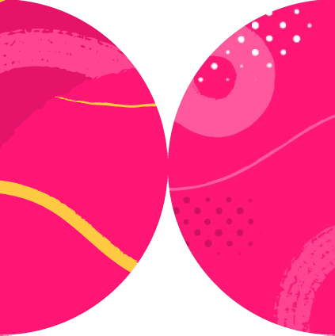

Using Locators

Slide 2

<form>
<div class="form-group">
<label for="nameInput">Name</label>
<input type="text">
</div>
<button type="submit">Submit</button>
</form>

Slide 3

Playwright.dev
Prioritize user-facing attributes and explicit contracts

Slide 4

.filter({ hasText: Item 2 })
<ul>
<li>
<p>Item 1</p>
<button>Add</button>
</li>
<li>
<p>Item 2</p>
<button>Add</button>
</li>
</ul>

Slide 5

const el = await page.$('list');
// assert count of 3
const el2 = await page.$('list');
// assert count of 9

Slide 6
const el = await page.getByLabel('list');
await expect(el).toHaveCount(3);
// ...
await expect(el).toHaveCount(9);
just-in-time fetching and evaluating

Slide 7
page
const button = page
.frameLocator('#bar')
.getByRole('button');
iframe[id=bar]
button

Slide 8

Summary
Prefer user-facing ways to locate elements
.locator(‘#someId’) Try the codegen tool

Slide 9

Up Next:
Using Playwright Basic Actions

